Slide 1


Confidential
Personal Finance and Warren Buffett Investing Strategy Toolkit
Overview

Slide 2


Introduction
This comprehensive Toolkit was created by former JP Morgan Investment Bankers, Value Equity Investors & Deloitte Consultants, after more than 4,000 hours of research into Warren Buffett’s methods. It includes frameworks, best practices, templates and Excel models to help you take control of your finances and build long-term wealth. By applying Buffett’s value investing principles—focusing on great companies at fair prices—you’ll learn how to invest with discipline, outperform the market, and make smarter financial decisions.
Join the 200,000+ Executives, Consultants & Entrepreneurs who are already leveraging our Toolkits to improve the performance of their organization and boost their own career.
If you have any questions, send us an email at support@domontconsulting.com and one of our ex-McKinsey, Deloitte & BCG Management Consultants will get back to you within 2 business days.
Aurelien Domont
Management Consultant
Domont Consulting Managing Director

Slide 3












Our firm created this Toolkit to help you take control of your finances and build long-term wealth
What’s inside the Toolkit?
Who created the Toolkit?
The Toolkit was created by ex-JP Morgan Investment Bankers, and McKinsey & Deloitte Consultants.
Best Practices
Frameworks
Number of professionals leveraging our Toolkits
Advice from
tier-1 Management Consultants
Tools
There are 200,000+ Executives, Consultants & Entrepreneurs leveraging our Toolkits to improve the performance of their organization
Real-life Examples
Templates
Trusted by small and large organizations
Video Training
Step-by-step Tutorials

Slide 4
Our Toolkit will help you fulfill multiple objectives
The Toolkit includes frameworks, tools, templates, tutorials, real-life examples, video training, and best practices to help you:
Take Control of your Finances: (1) Net worth calculator and dashboard, (2) Income, costs and savings calculator and dashboard, (3) Investment options and recommendations for building wealth
Understand Warren Buffett’s Value Investing Strategy, which comes from 6 books: (1) The Intelligent Investor, (2) Security Analysis, (3) Common Stocks and Uncommon Profits, (4) The Essays of Warren Buffett, (5) The Warren Buffett Way, (6) One Up On Wall Street
Define and Implement Warren Buffett Value Investing Strategy: (1) Strategic objective, (2) Portfolio strategy, (3) Attitude & mindset, (4) Decision-making process, (5) Investment frequency, (6) Cash on hand, (7) Horizon, (8) Financial models in Excel
Identify Opportunities with our Stock Watchlist and Screener in Excel including real-time data
Implement Warren Buffett’s Stock Investment Decision-making Process: (1) Is this investment a good fit for me?, (2) Is it a good company?, (3) Is it a good price?, (4) Should I invest?
Manage your Stock Portfolio Effectively: (1) Trade records in Excel, (2) Stock portfolio performance in Excel, (3) Stock portfolio dashboard
1
2
3
4
5
6

Slide 5
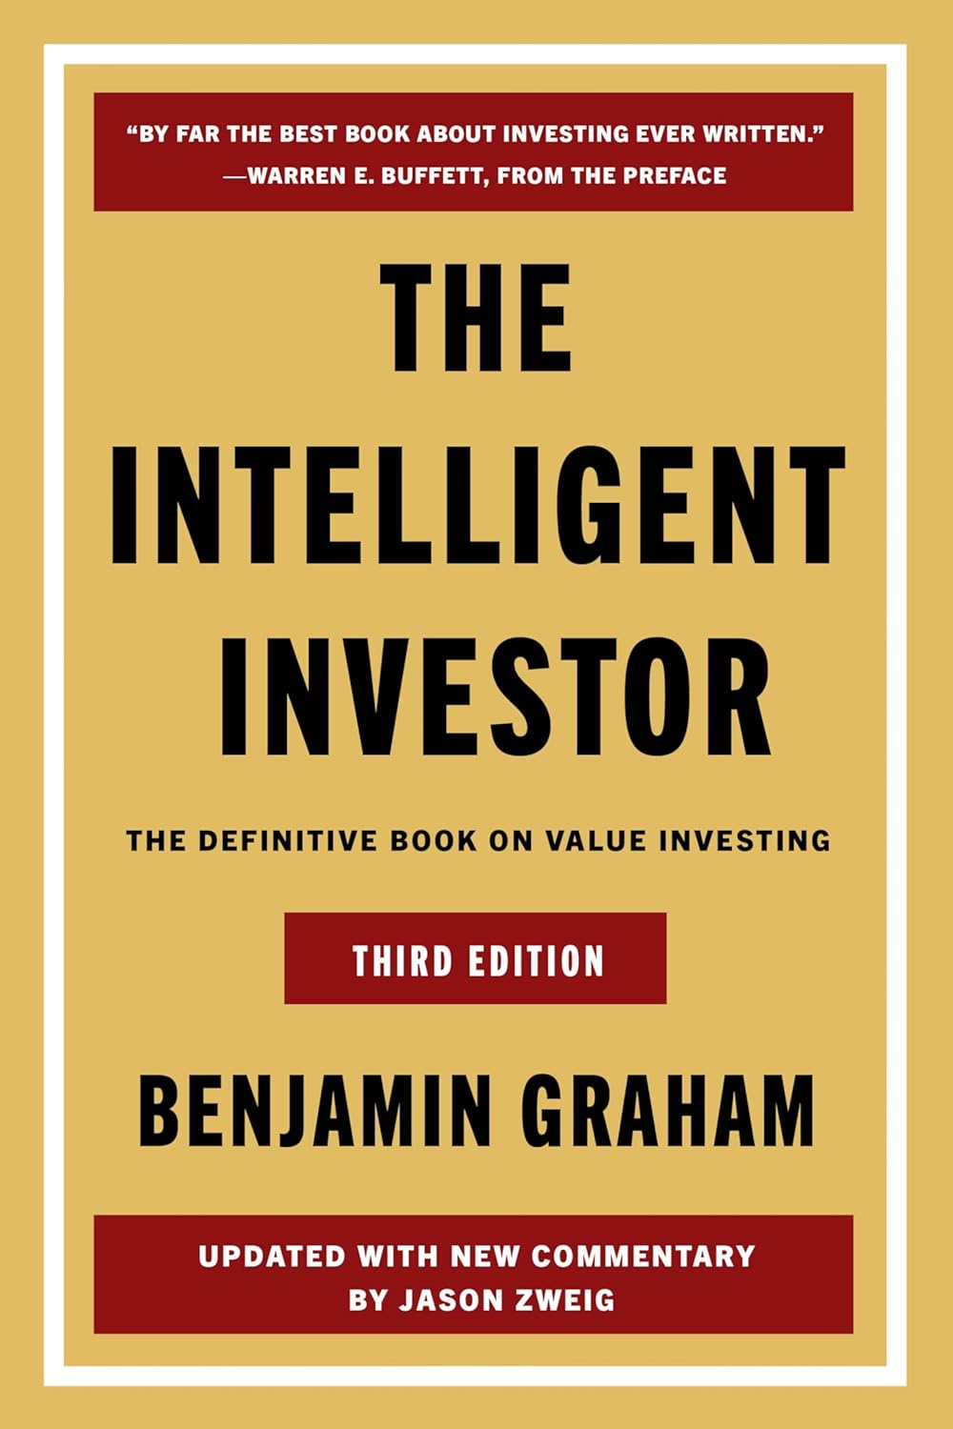
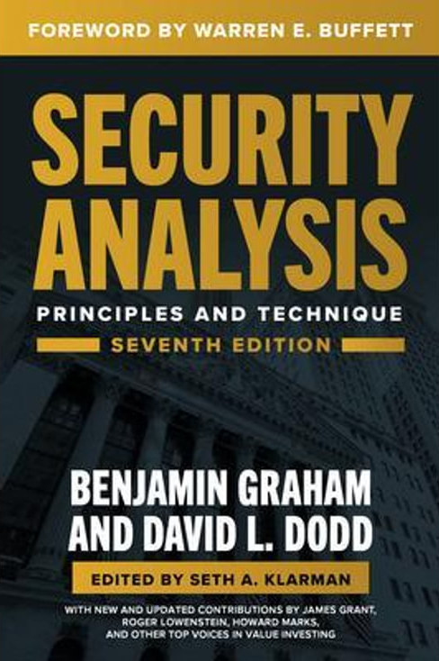
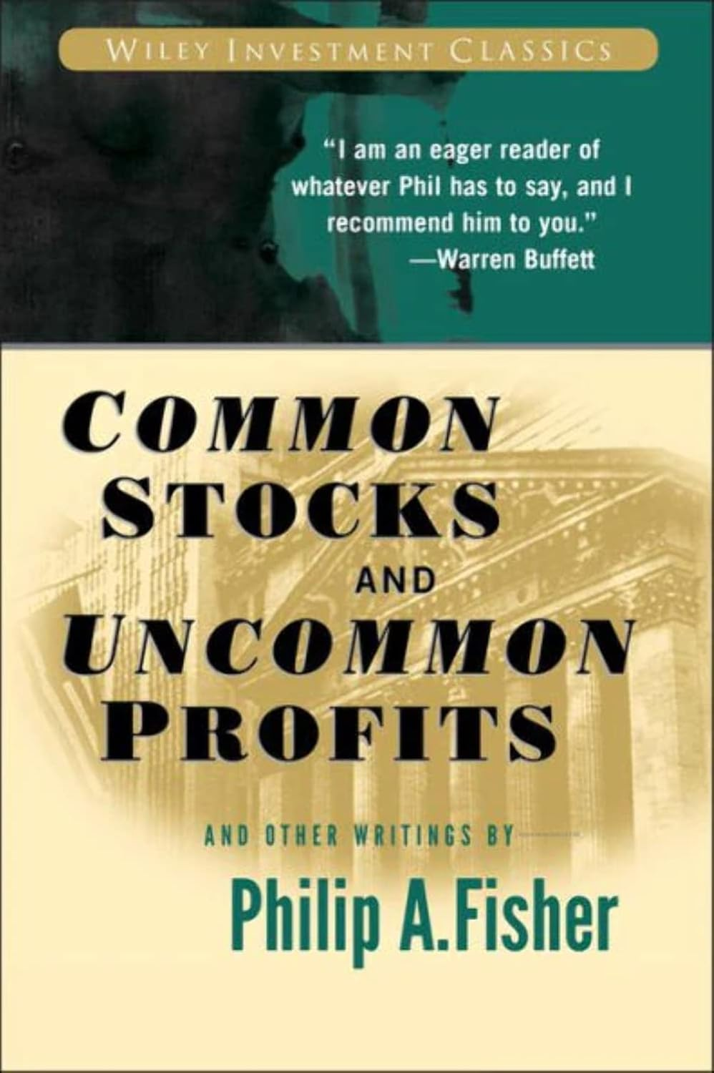
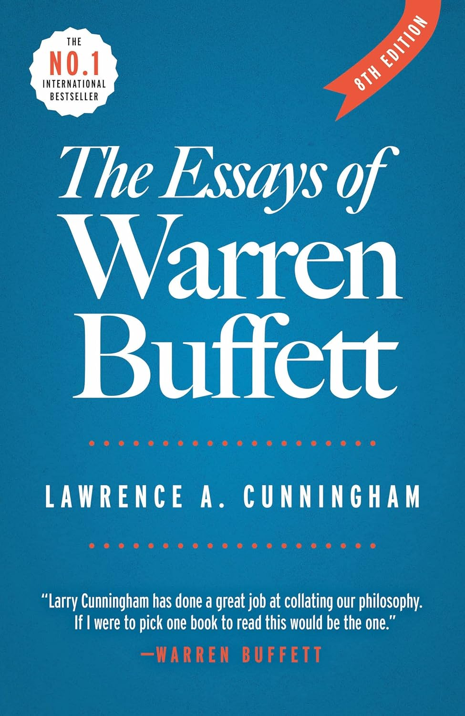
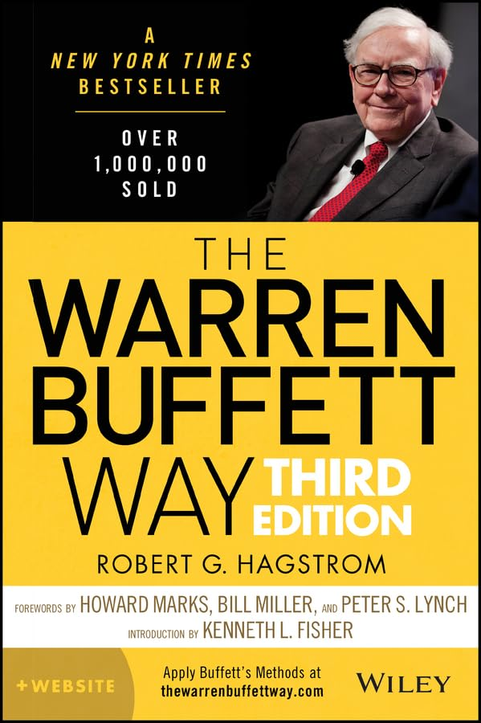





Structure of the Toolkit
1
Personal Finance
Net Worth Calculator and Dashboard
Income, Costs and Savings Calculator and Dashboard
Investment Options and Recommendations for Building Wealth
Warren Buffett Value Investing Philosophy
2
Warren Buffett Value Investing Strategy
Strategic Objective
Portfolio Strategy
Attitude & Mindset
Decision-making Process
Investment Frequency
Cash on Hand
Horizon
Financial Models in Excel
3
Stock Watchlist and Screener in Excel with real-time data
4
Detailed Stock Investment Decision-making Process
Is this investment a good fit for me?
Is it a good company?
Is it a good price?
Should I invest?
Business model understanding
Financial statements understanding
Industry understanding
Portfolio strategy alignment
Etc.
A product/service that is needed/desired
A solid and lasting MOAT/Competitive advantage
Earnings growth over the next 5 years above inflation without dilution
Etc.
Discounted cash flow model
Discounted owner earnings model
Estimated internal rate of return > 10%
Insider transactions
Etc.
Good Fit
For me?
5
Good Company?
Good Price?
6
Stock Portfolio Management
Trade Records in Excel
Stock Portfolio Performance in Excel
Stock Portfolio Dashboard

Slide 6

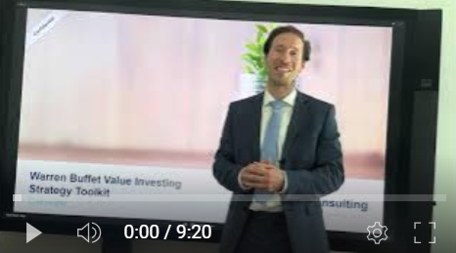
Video demonstration of the sections 3–6 of the Toolkit
Video Demo Access
Video Demo Visual
Select “Slide Show” mode and then click on the link below or on the image on the right to access this video demo.
You can also access the video by copy pasting the following URL in your browser:
https://youtu.be/VlzHk3asBho

Slide 7
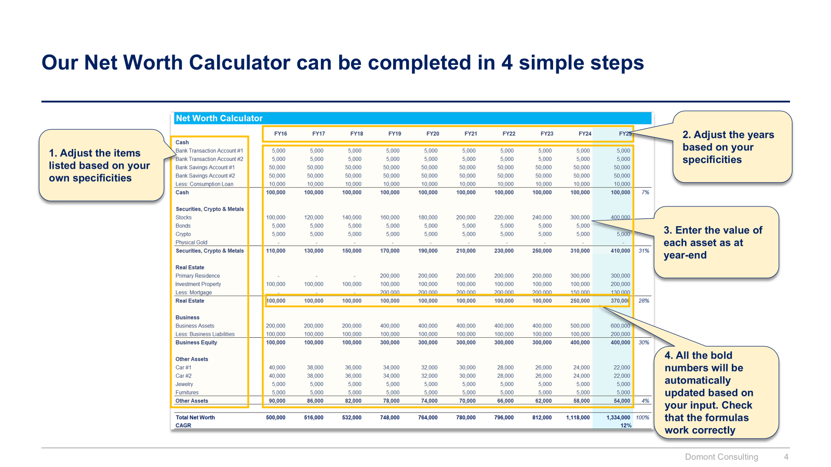
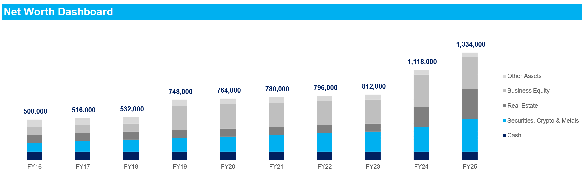
Small preview of the section 1 “Personal Finance”

Slide 8
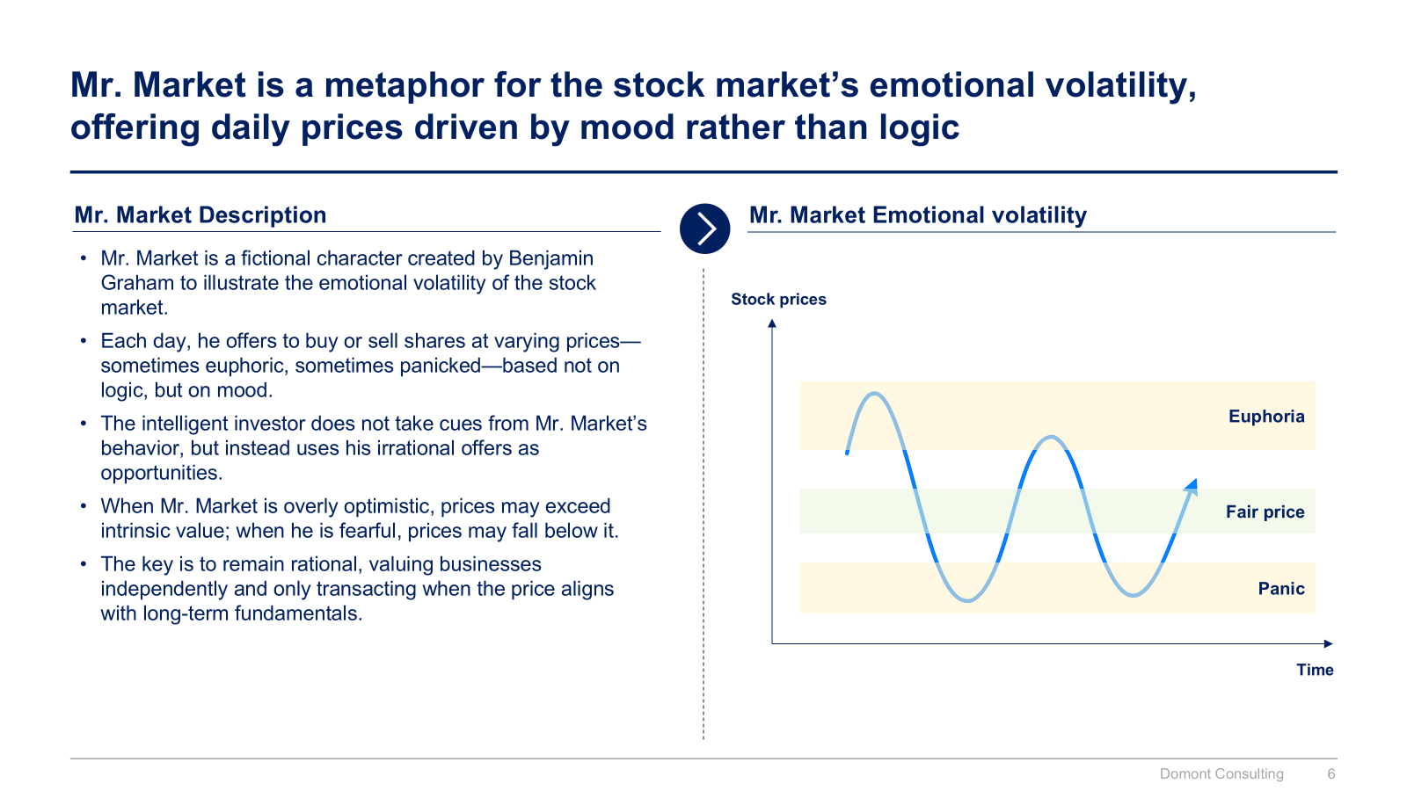
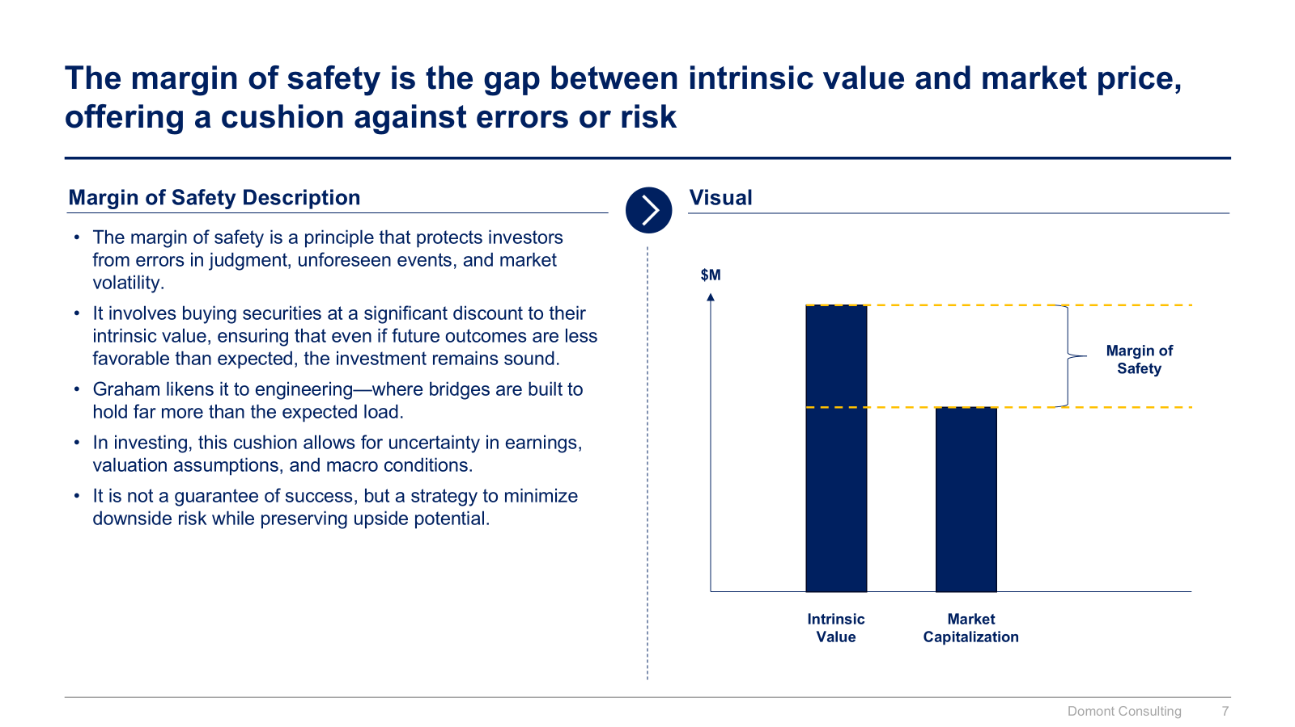
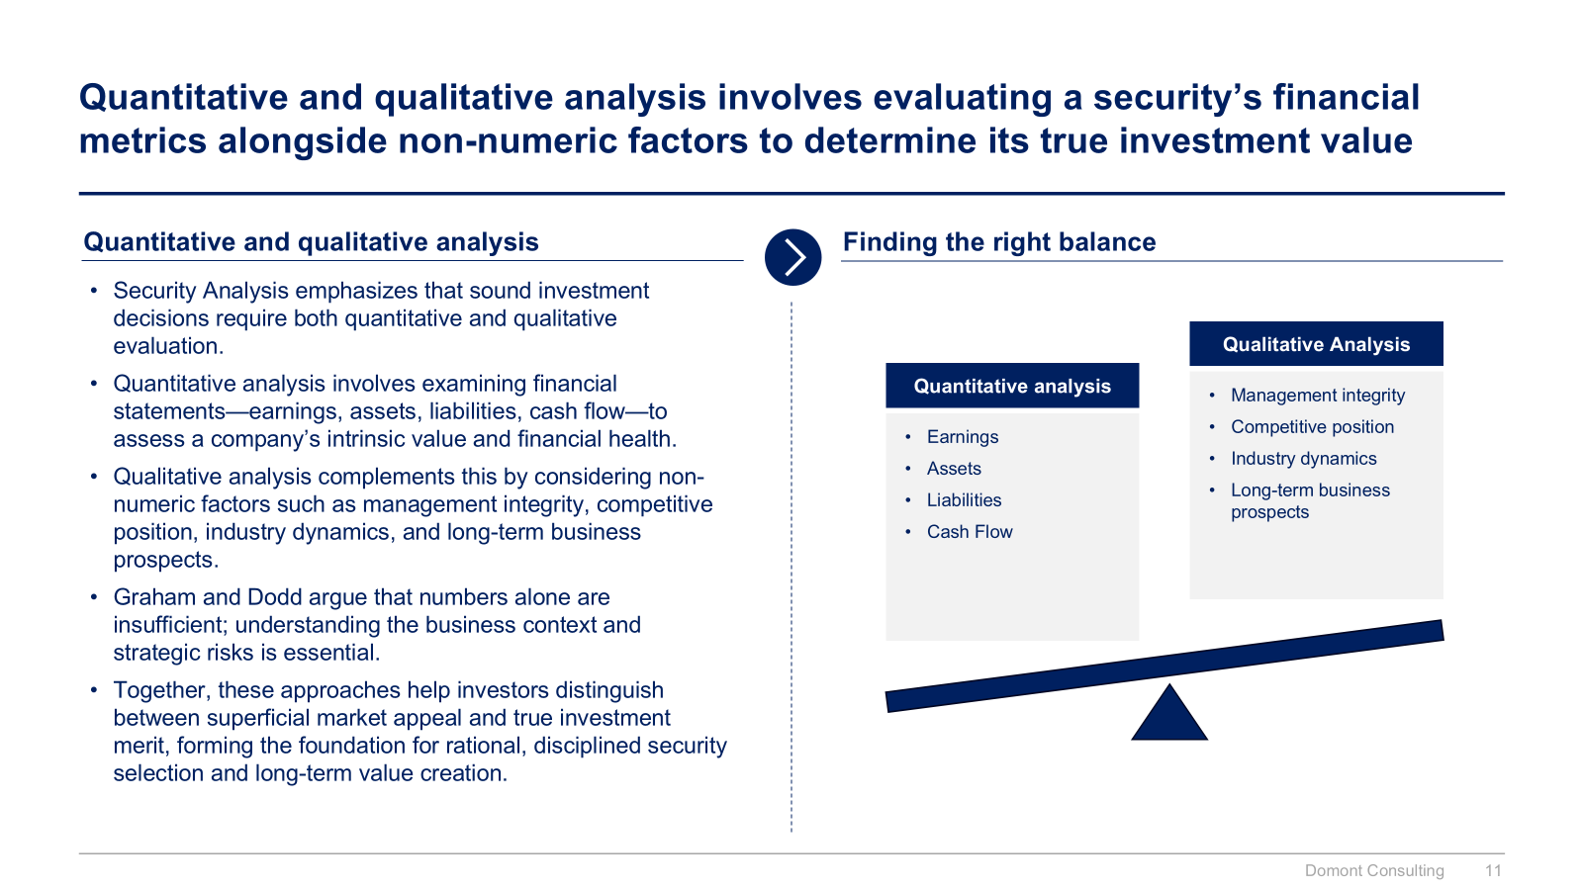
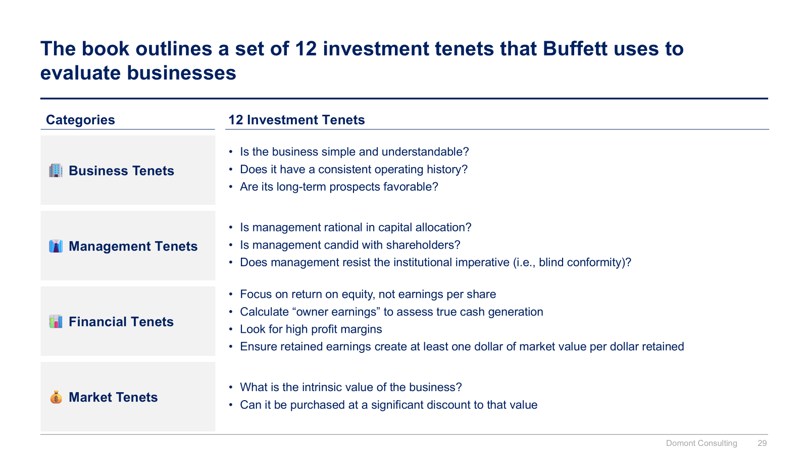
Small preview of the section 2 “Warren Buffett Value Investing Philosophy”

Slide 9
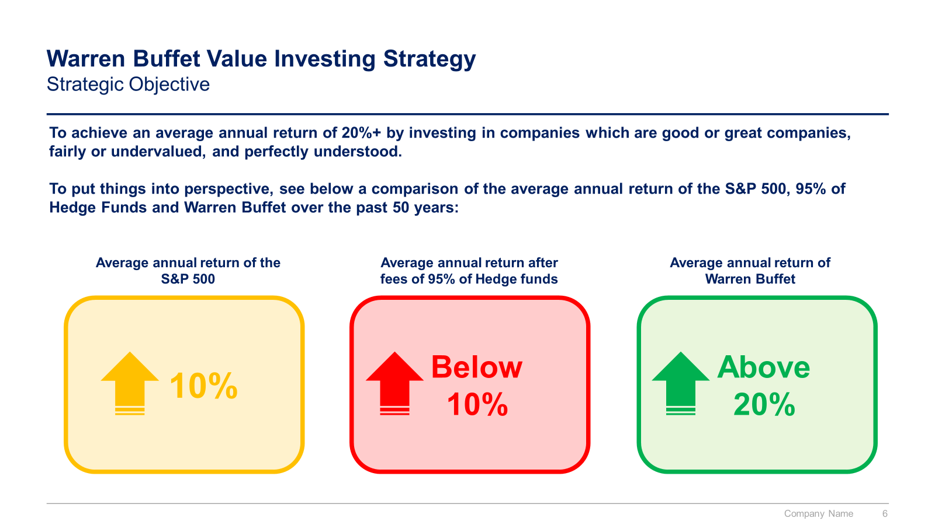
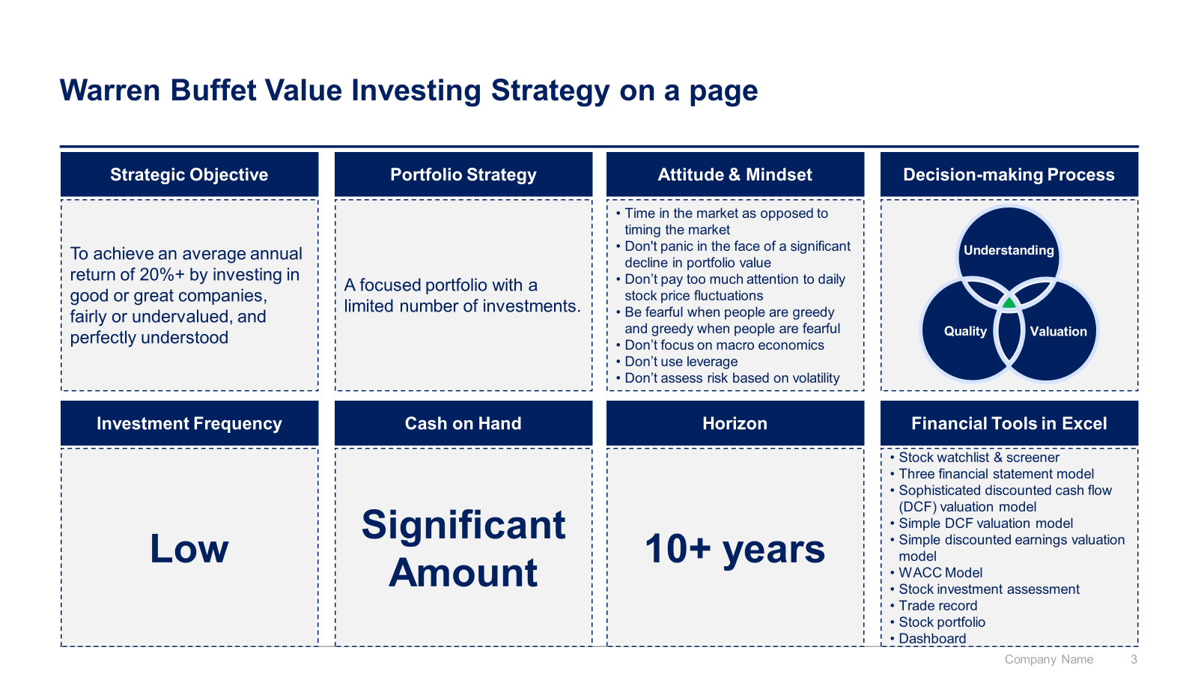
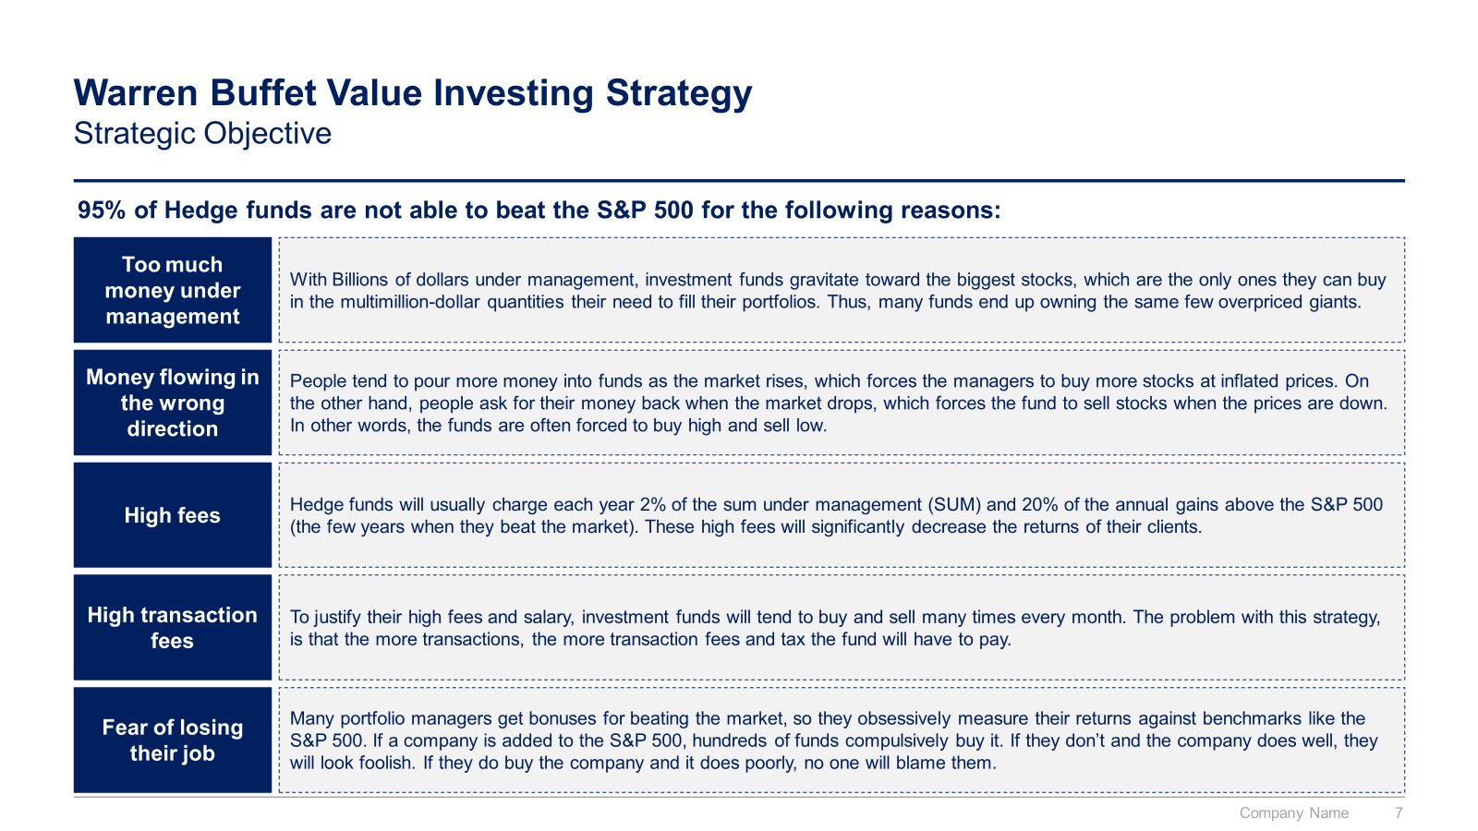
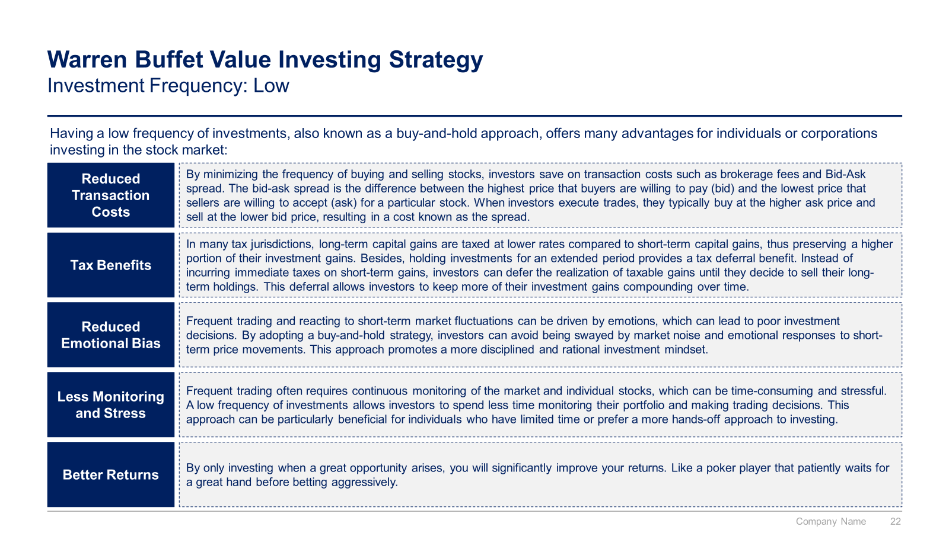
Small preview of the section 3 “Warren Buffett Value Investing Strategy”

Slide 10
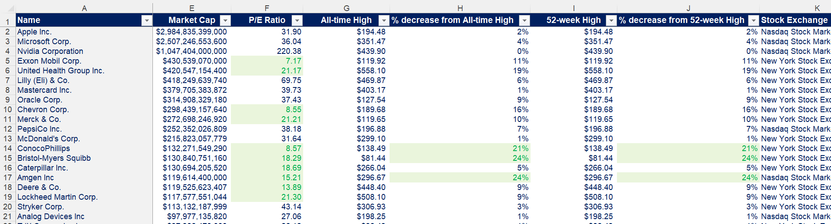
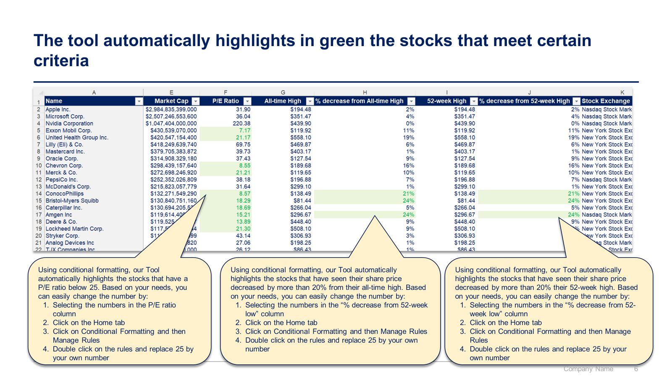
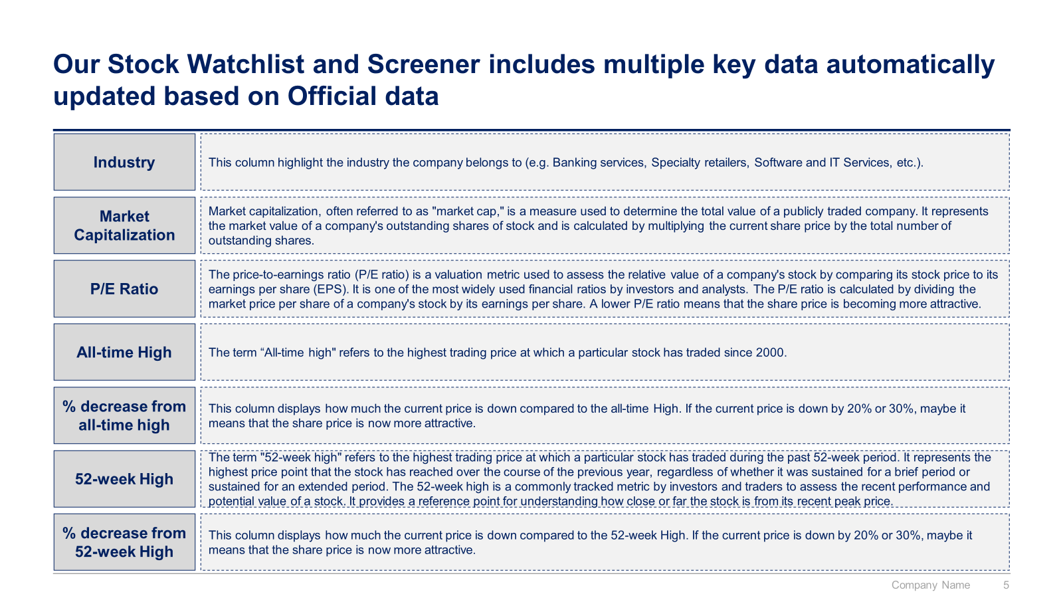
Small preview of the section 4 “Stock Watchlist and Screener in Excel with real-time data”

Slide 11
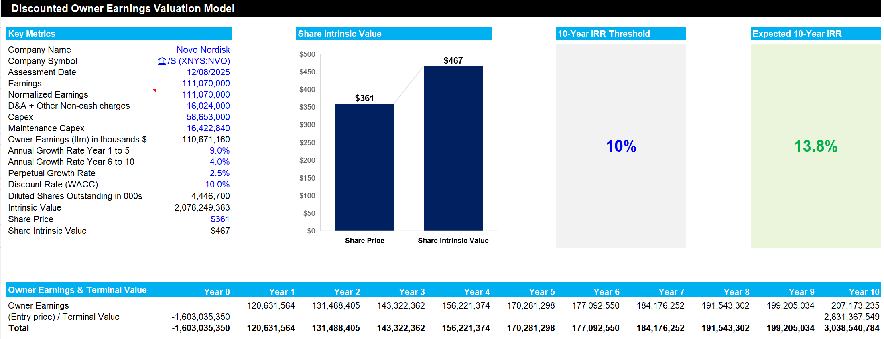
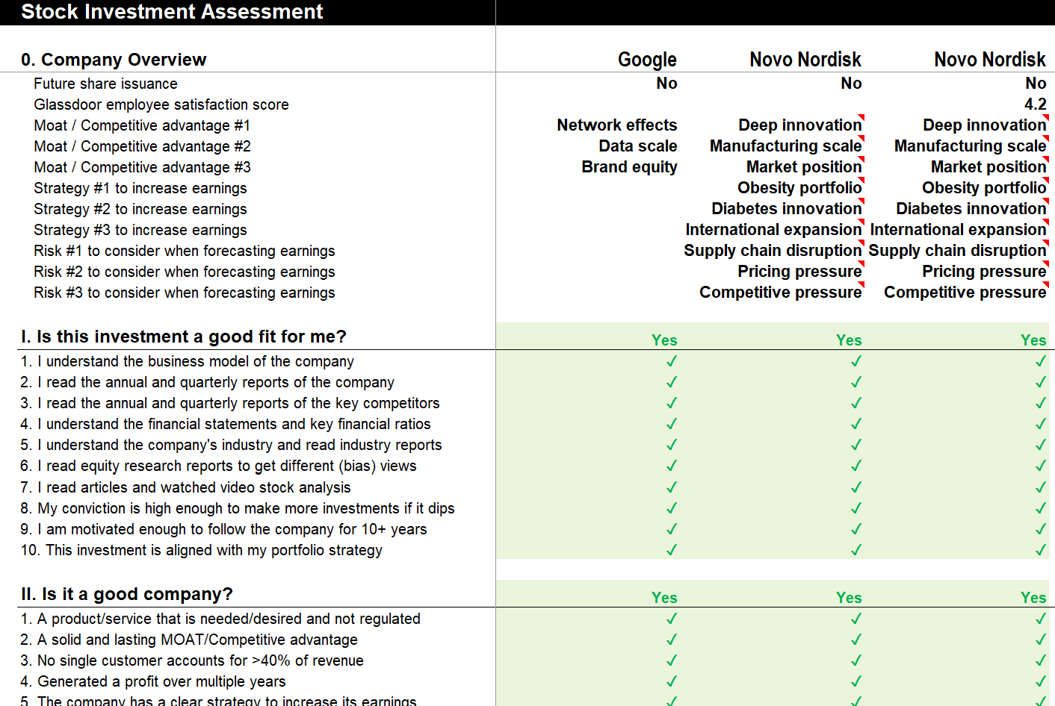
Small preview of the section 5 “Detailed Stock Investment Decision-making Process”

Slide 12
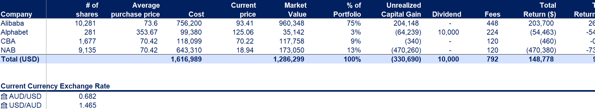
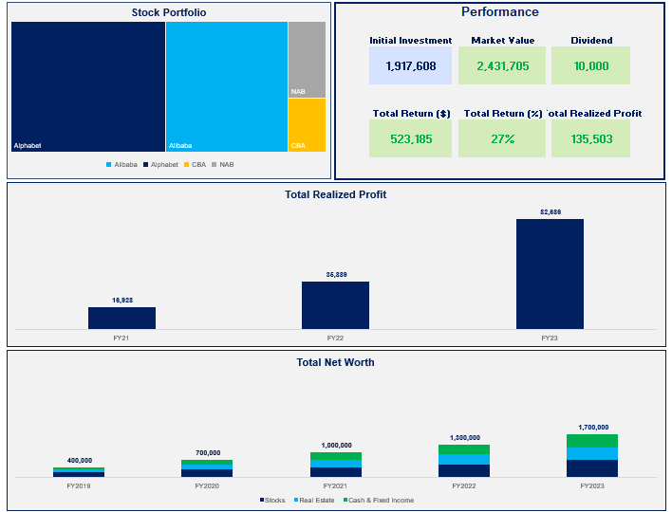
Small preview of the section 6 “Stock Portfolio Management”

Slide 13



The Toolkit includes multiple PowerPoint slides, Excel sheets and Video training that you can download on your device immediately after purchase
300 editable PowerPoint slides*
24 Excel sheets*
19 minutes of Video training
Personal Finance
Warren Buffett Value Investing Philosophy
Warren Buffett Value Investing Strategy
Stock Watchlist and Screener
Investment Decision-making Process
Stock Portfolio Management
*Please note that the number of Powerpoint slides and Excel sheets listed is the number of unique slides and sheets. For example, a Powerpoint slide that has been duplicated to facilitate our clients’ understanding only counts for one slide

Slide 14









Our Management Consulting Toolkits include 9 key benefits
Improve the growth & efficiency of your organization by leveraging Management Consulting Toolkits created by ex-McKinsey, Deloitte & BCG Consultants.
Make a great investment for your career & organization. It cost us US$8M+ over the past 10 years to create all our Toolkits. Get them for a fraction of this cost.
Get a competitive advantage. It’s like hiring Management Consultants to create all the practical Frameworks, Tools & Templates you need.
Get the job done quicker and never start from scratch again with our ready-made and fully editable Frameworks, Tools & Templates in Powerpoint & Excel.
Don't reinvent the wheel. We have already worked 30,000+ hours over the past 10 years to create all the Management Consulting Toolkits you need.
Improve the capabilities of your organization by learning how the Fortune 100 and Global Consulting Firms do it.
Decrease your costs. Hiring tier-1 Consultants for a project would cost you $300k+. Way more expensive than our Toolkits, which will last you a lifetime!
Become your organization’s subject matter expert and impress your stakeholders with world-class approaches to resolve common business problems.
Get free support and advice from our ex-McKinsey, Deloitte & BCG Management Consultants.

Slide 15
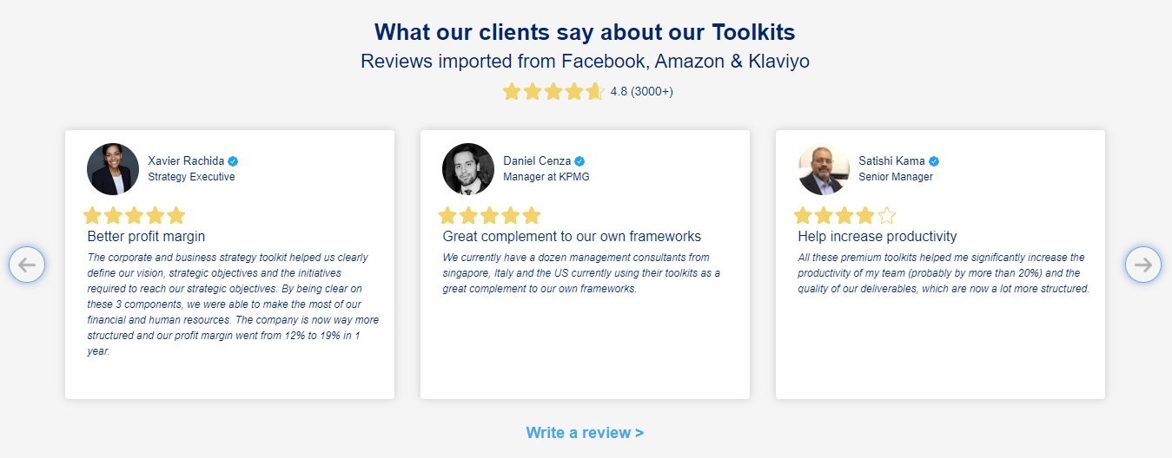
What our clients say about our Toolkits
Click here to see more reviews >

Slide 16

Join 200,000+ Executives, Consultants & Entrepreneurs leveraging our Toolkits to improve the performance of their organization
Trusted by small and large organizations
Customer satisfaction
4.8
Number of countries leveraging our Toolkits
160+
Number of professionals leveraging our Toolkits
200,000+
Daily rate of our ex-McKinsey, Deloitte and BCG Management Consultants
$3k-$4k

Slide 17

Interested in more than 1 Toolkit? Access all our Toolkits for half the price with our Gold Access
Gold Access
Click here to learn more

Slide 18
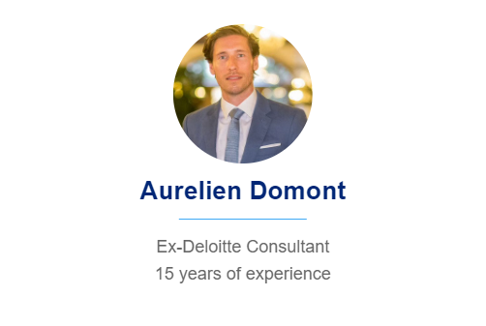

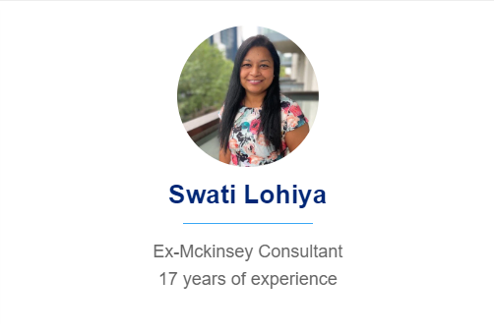



Need additional help? Send us a brief and we’ll find you the right talent from our network of 500+ tier-1 Management Consultants
Click here to send us a Project Brief

Slide 19

This was just a small preview.
www.domontconsulting.com

